Slide 1
CS7/8745 : Machine Learning Instructor: Salim Sazzed Department of Computer Science University of Memphis

Slide 2
Decision Tree

Slide 3
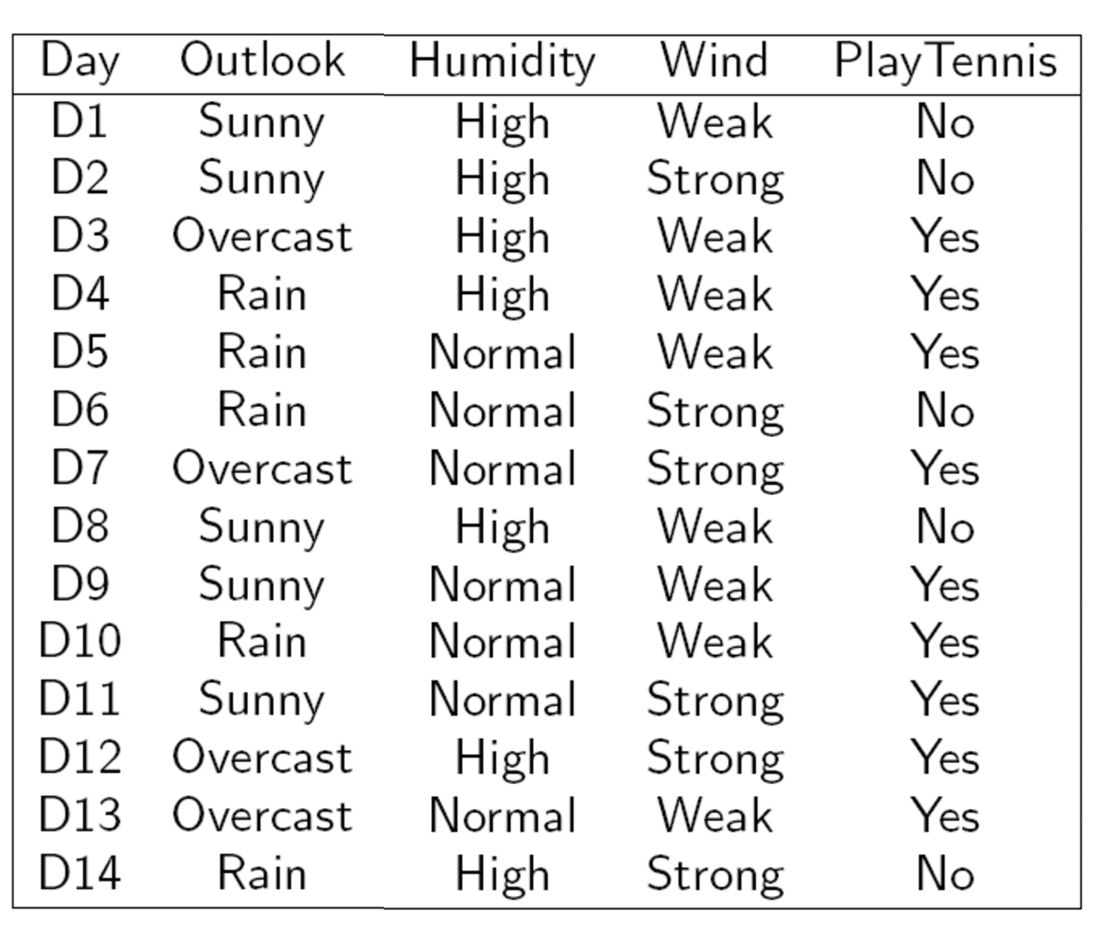
Target
14 samples
Each column represent one feature
Three Feature/Attributes

Slide 4
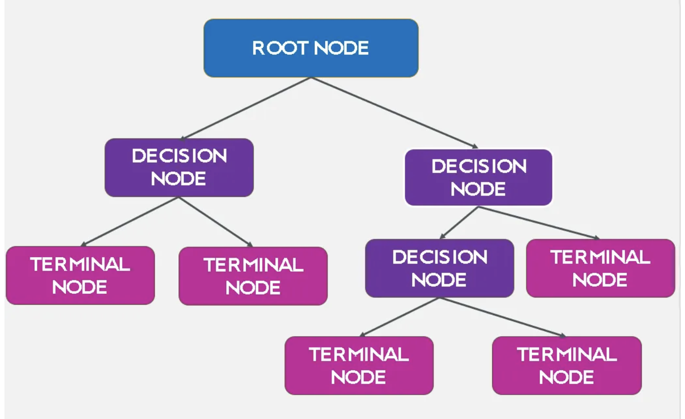
Structure of a Decision Tree
https://medium.com/

Slide 5
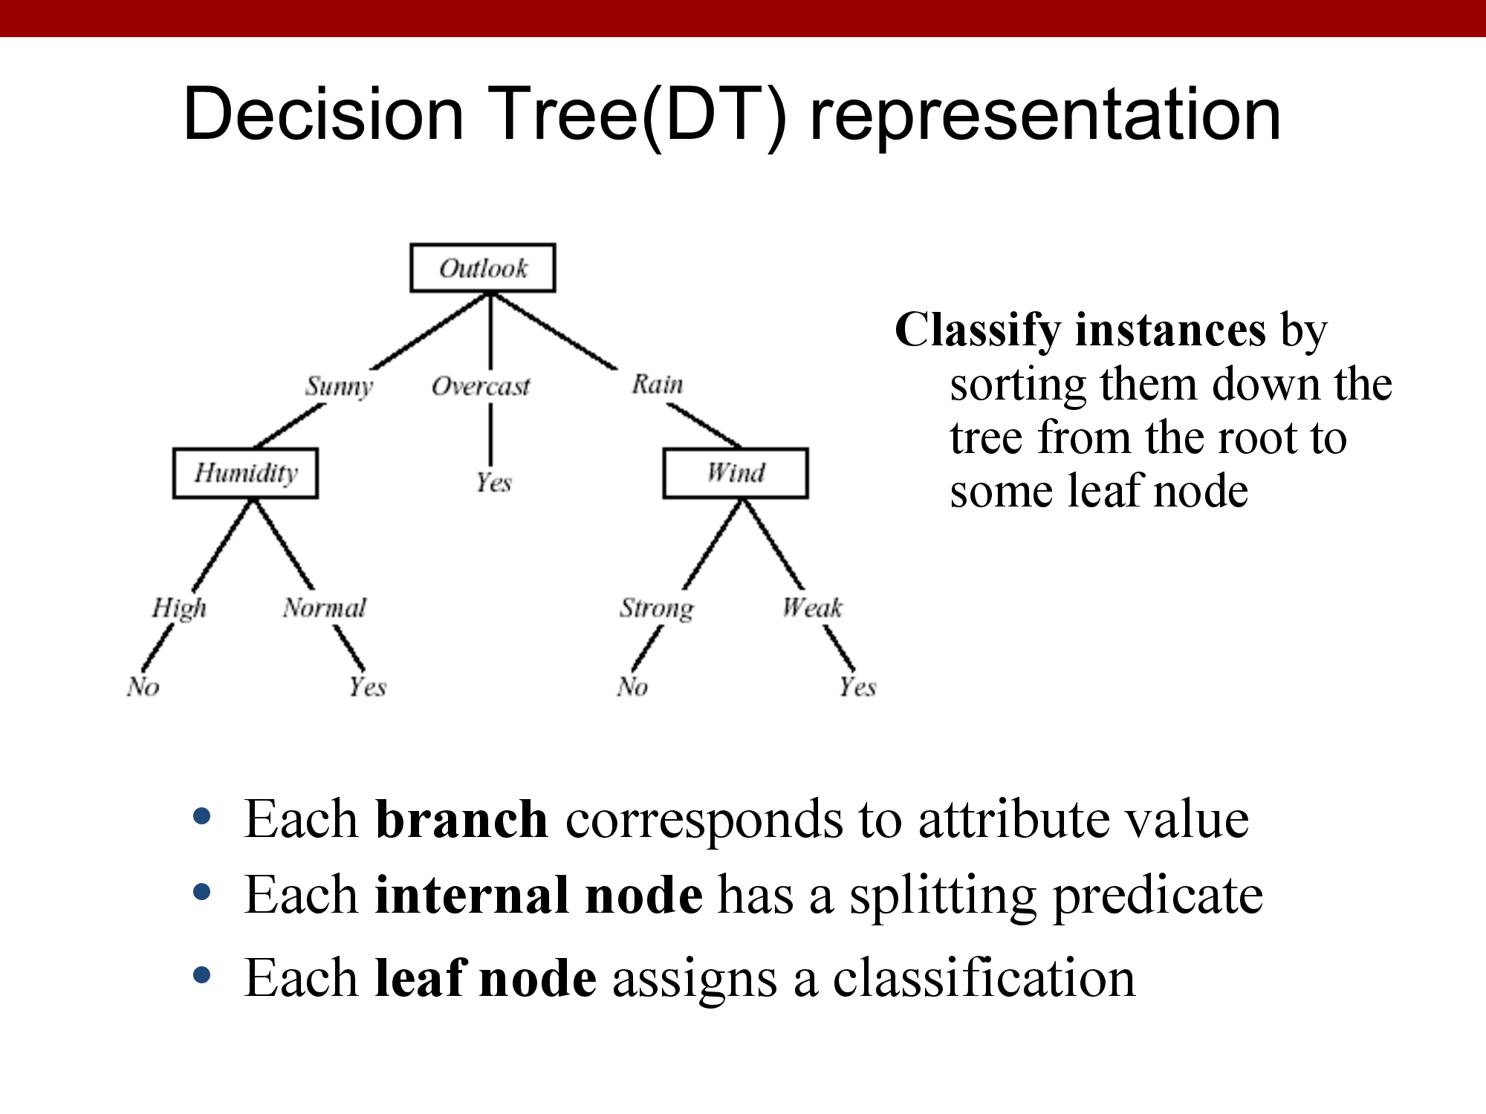
Internal node = Attribute/Feature
Branches = values of attribute/feature
Leaf = Target

Slide 6
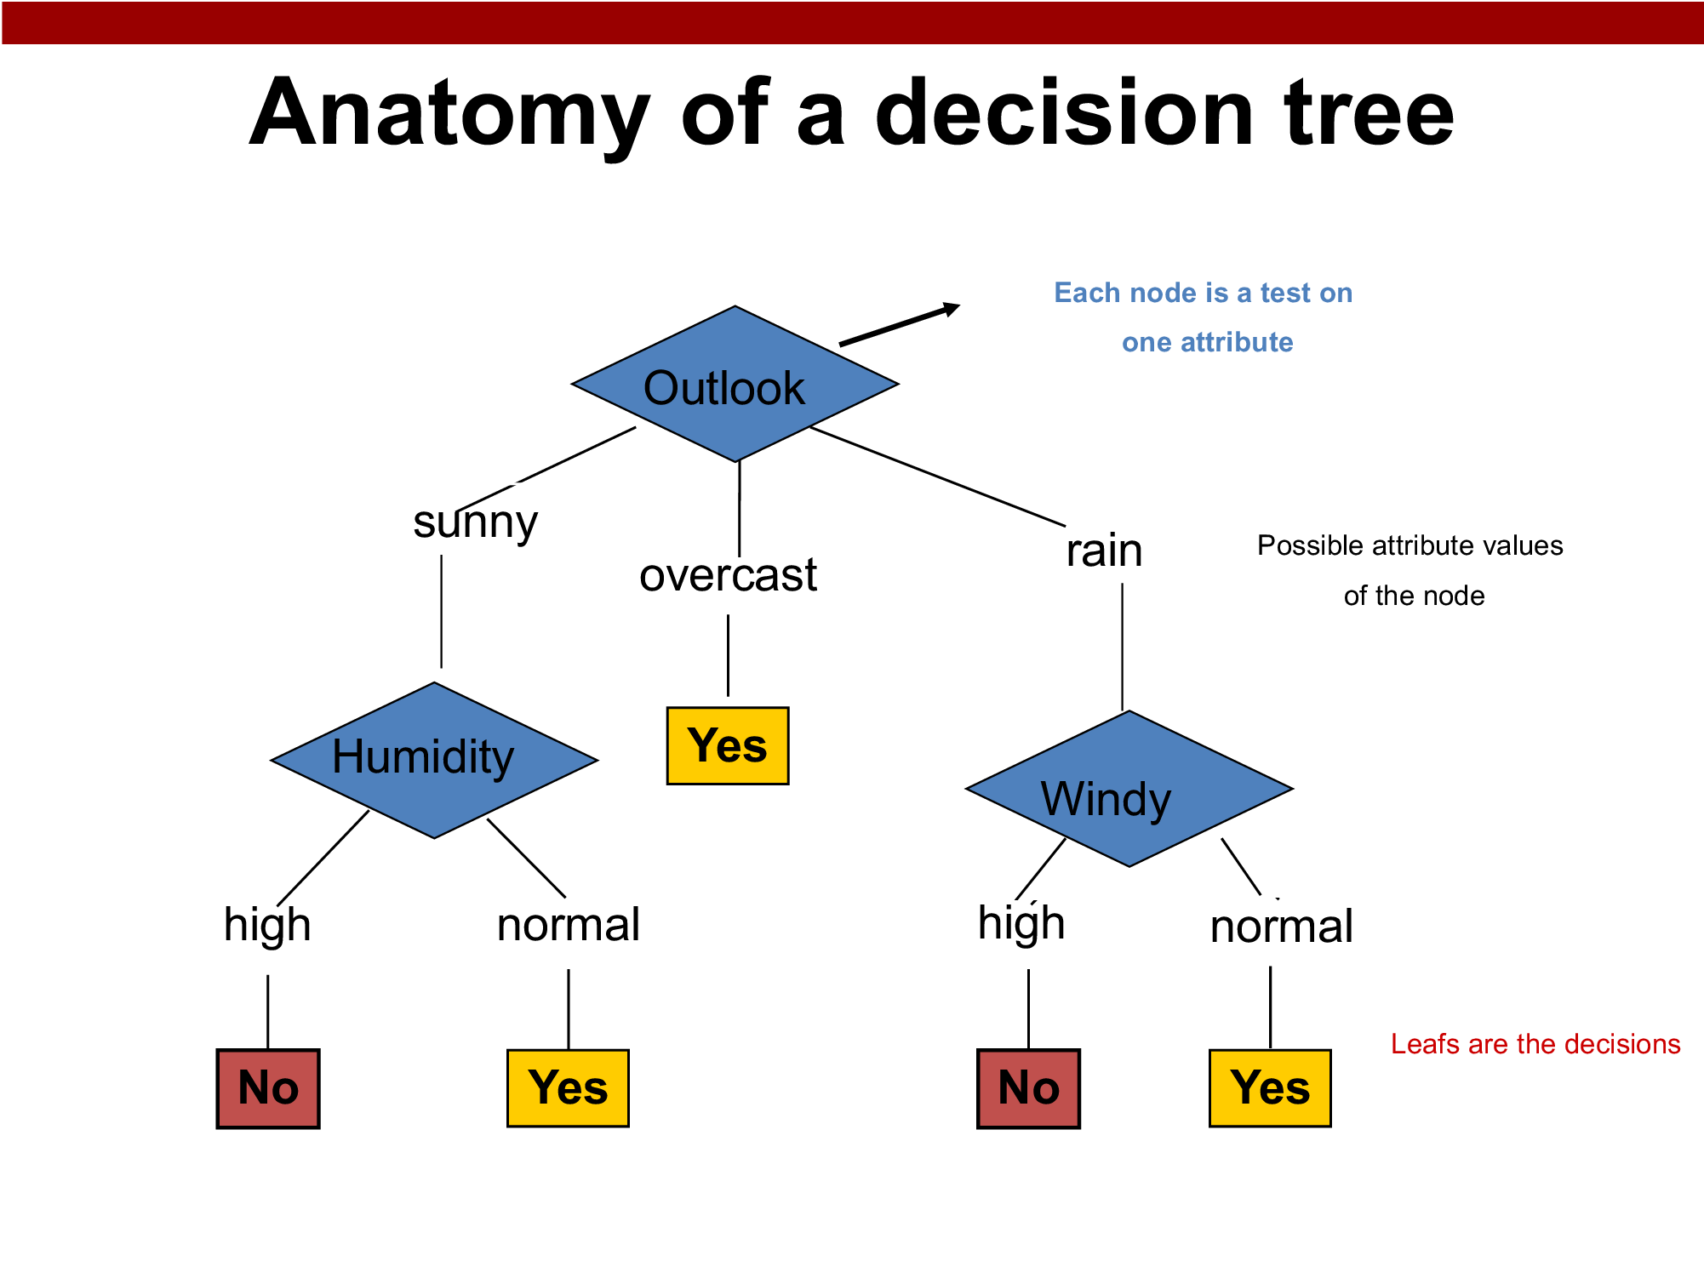
Each attribute (feature) is typically used only once along a single path from the root to a leaf node.

Slide 7
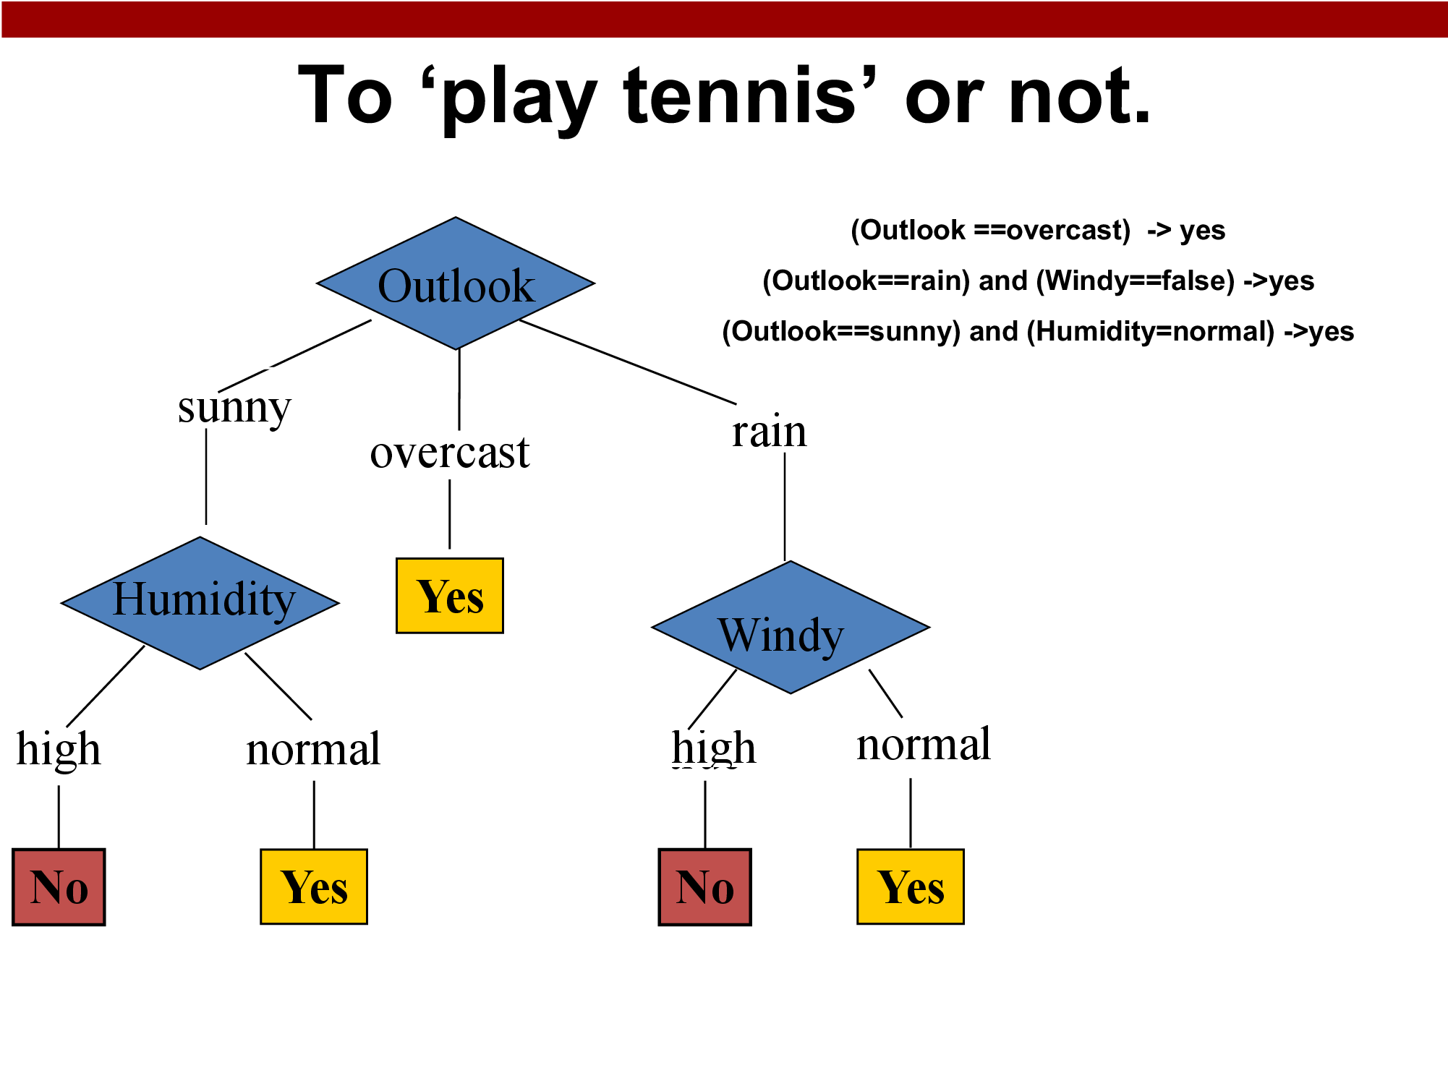
Generate Rules:
What rules this decision tree represents?

Slide 8
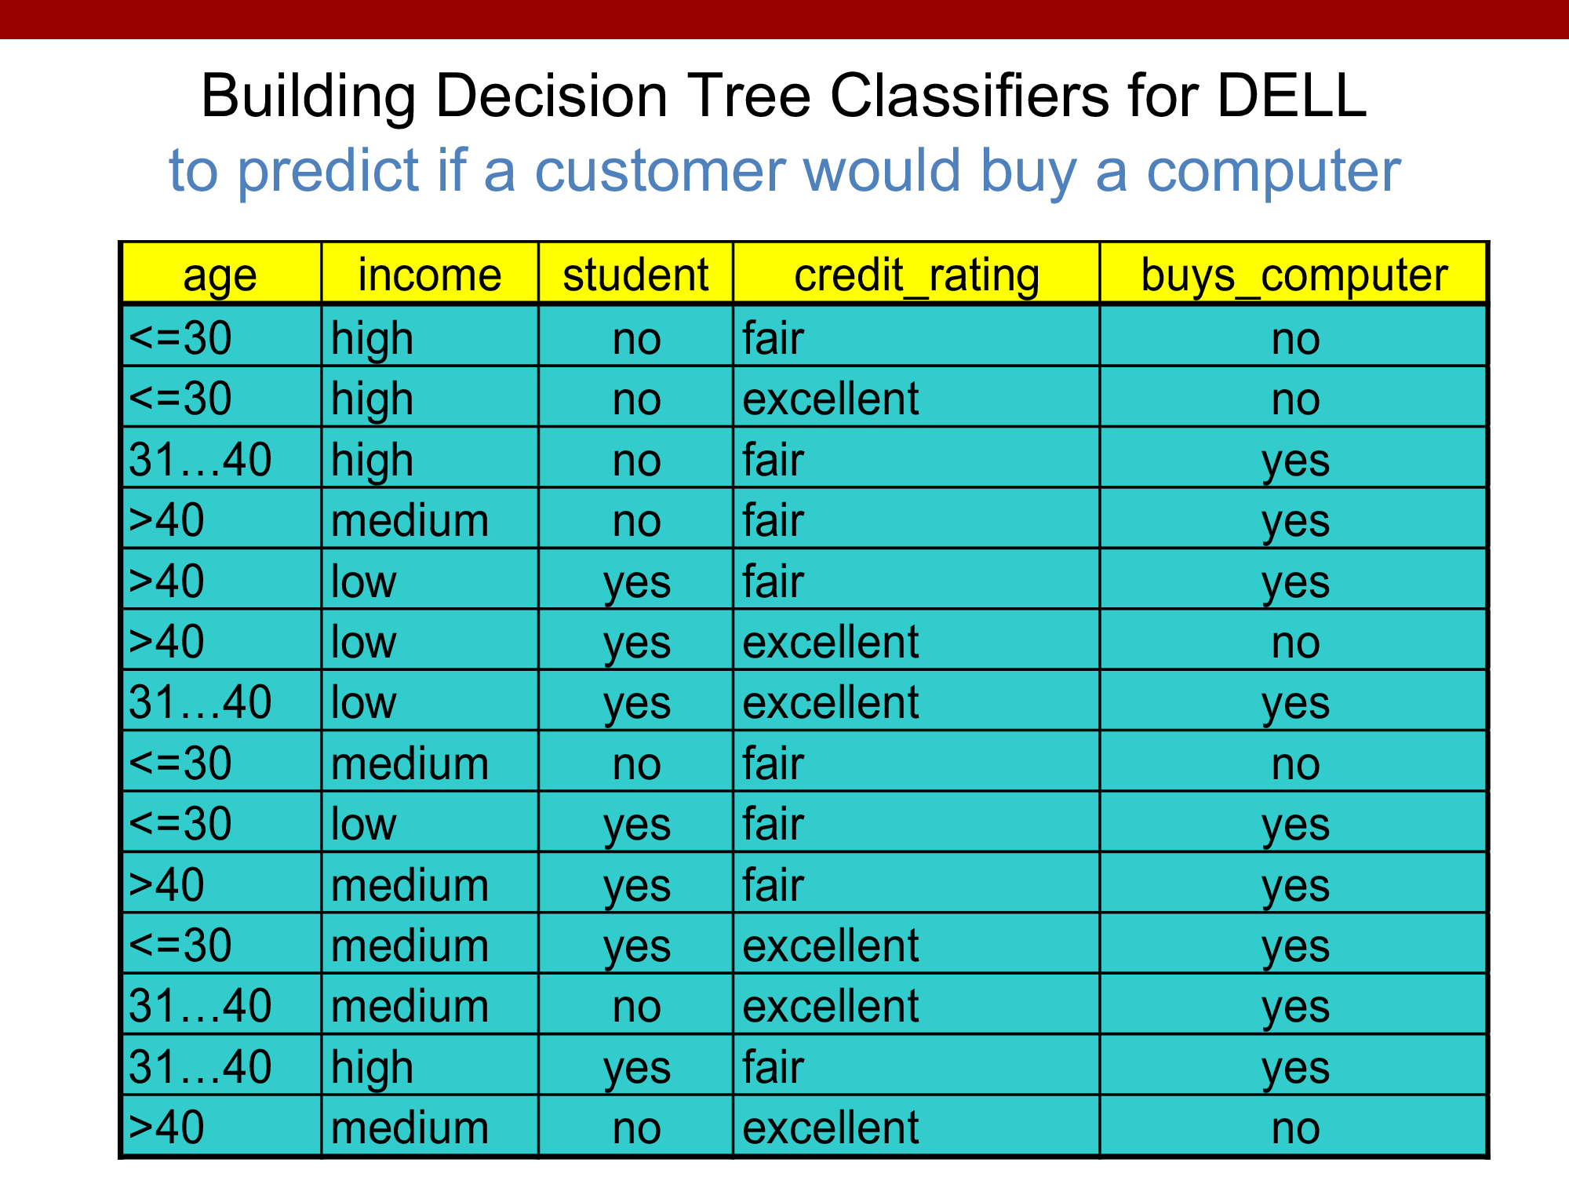

Slide 9
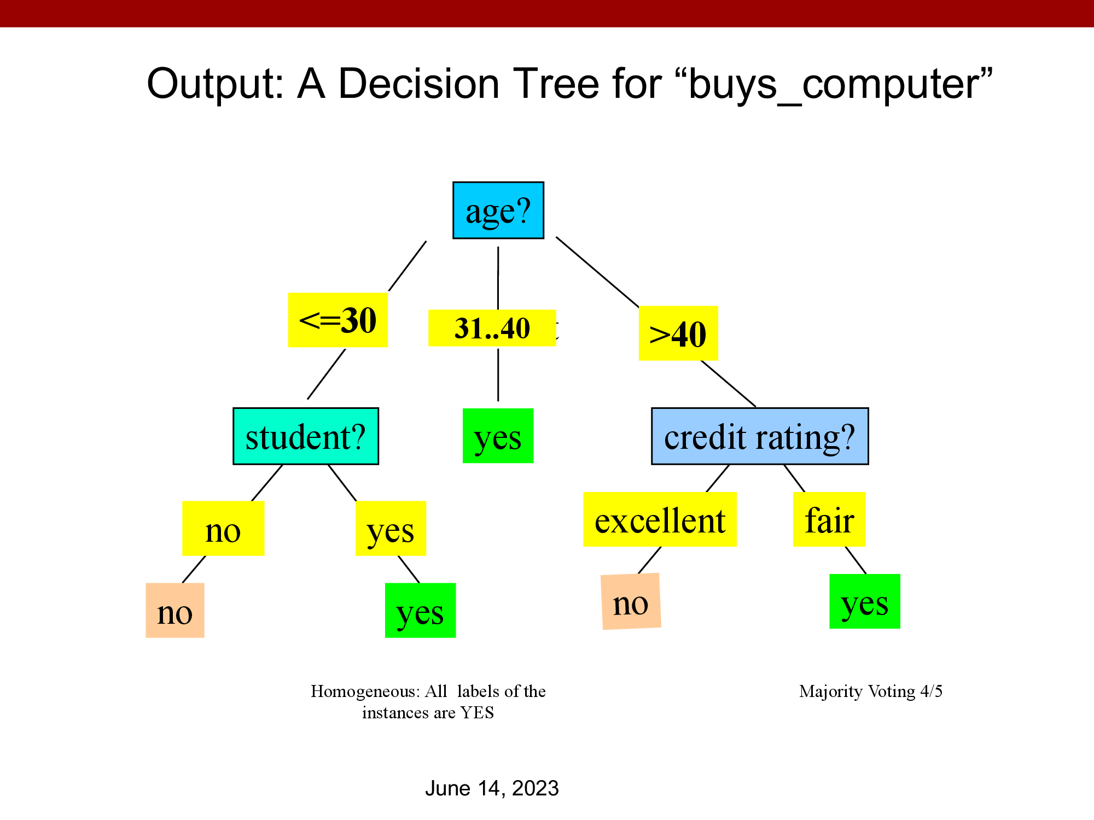

Slide 10
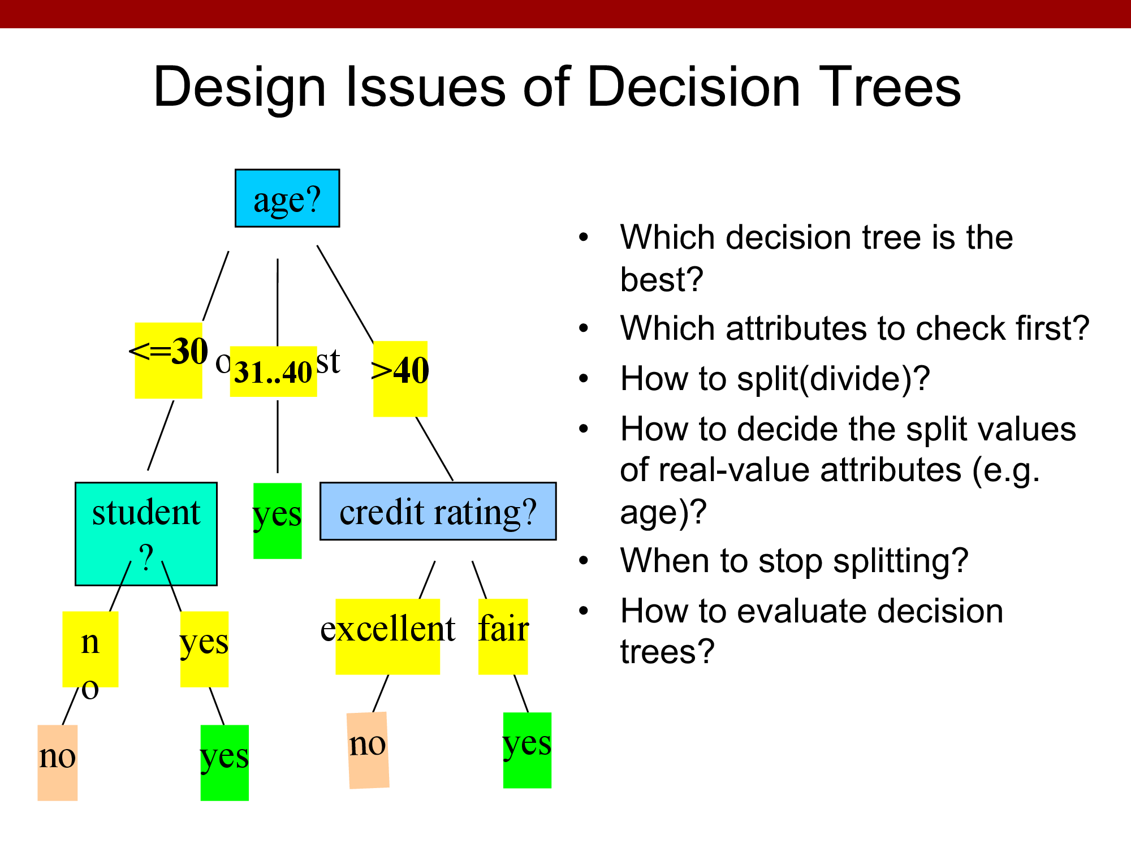

Slide 11
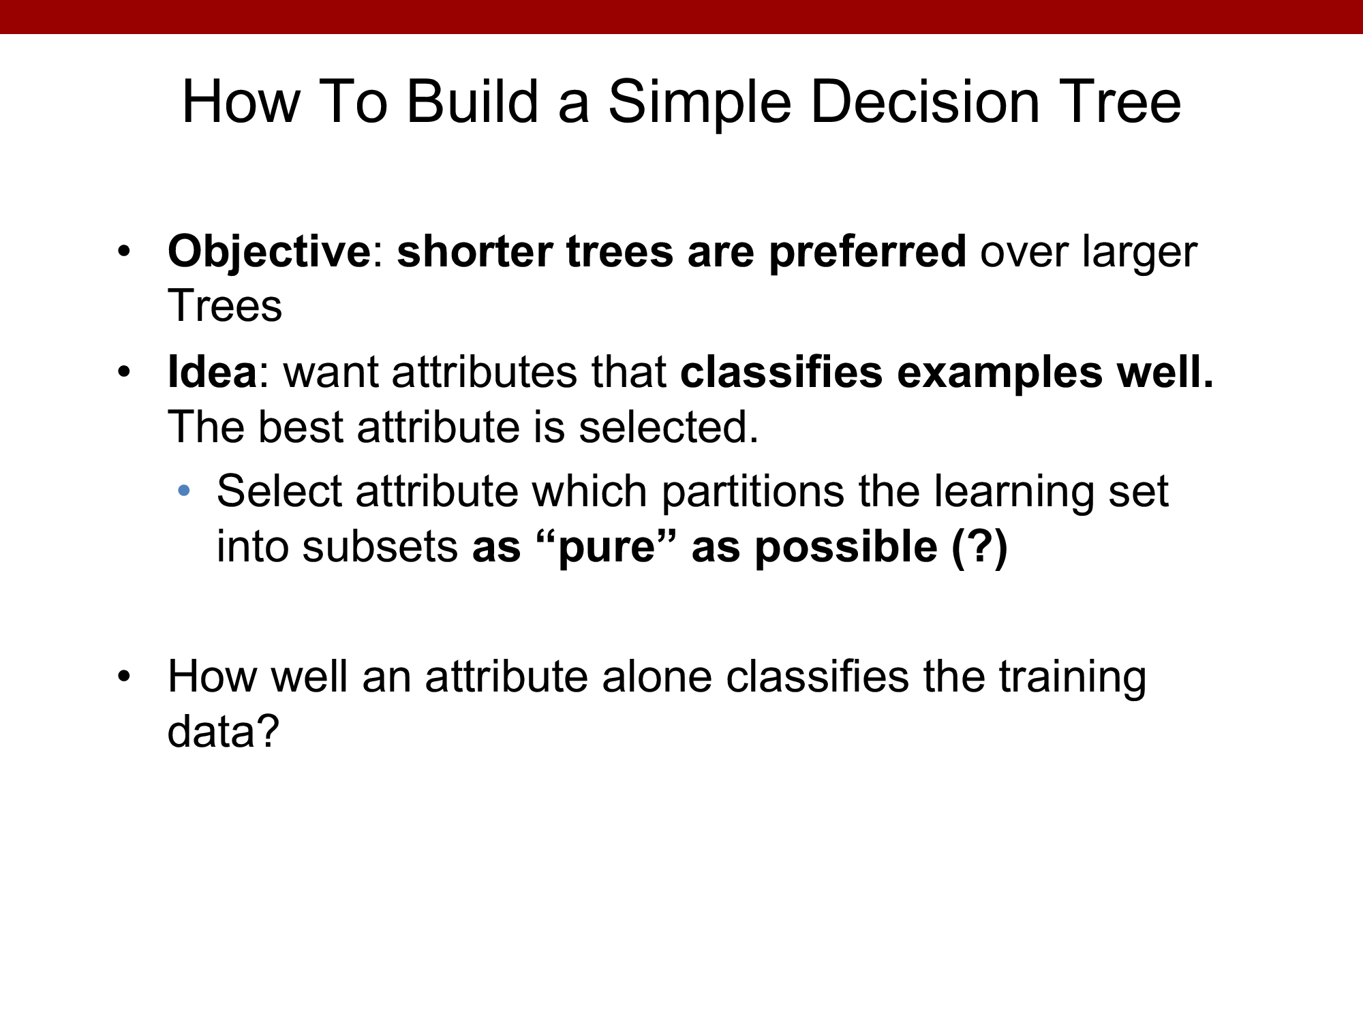

Slide 12
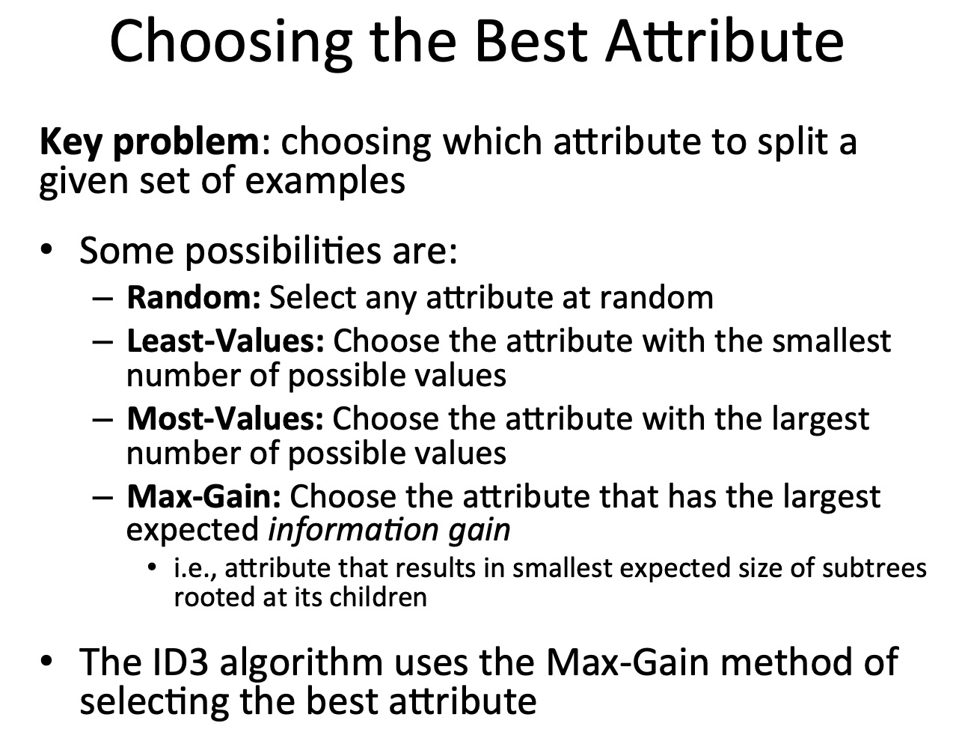

Slide 13
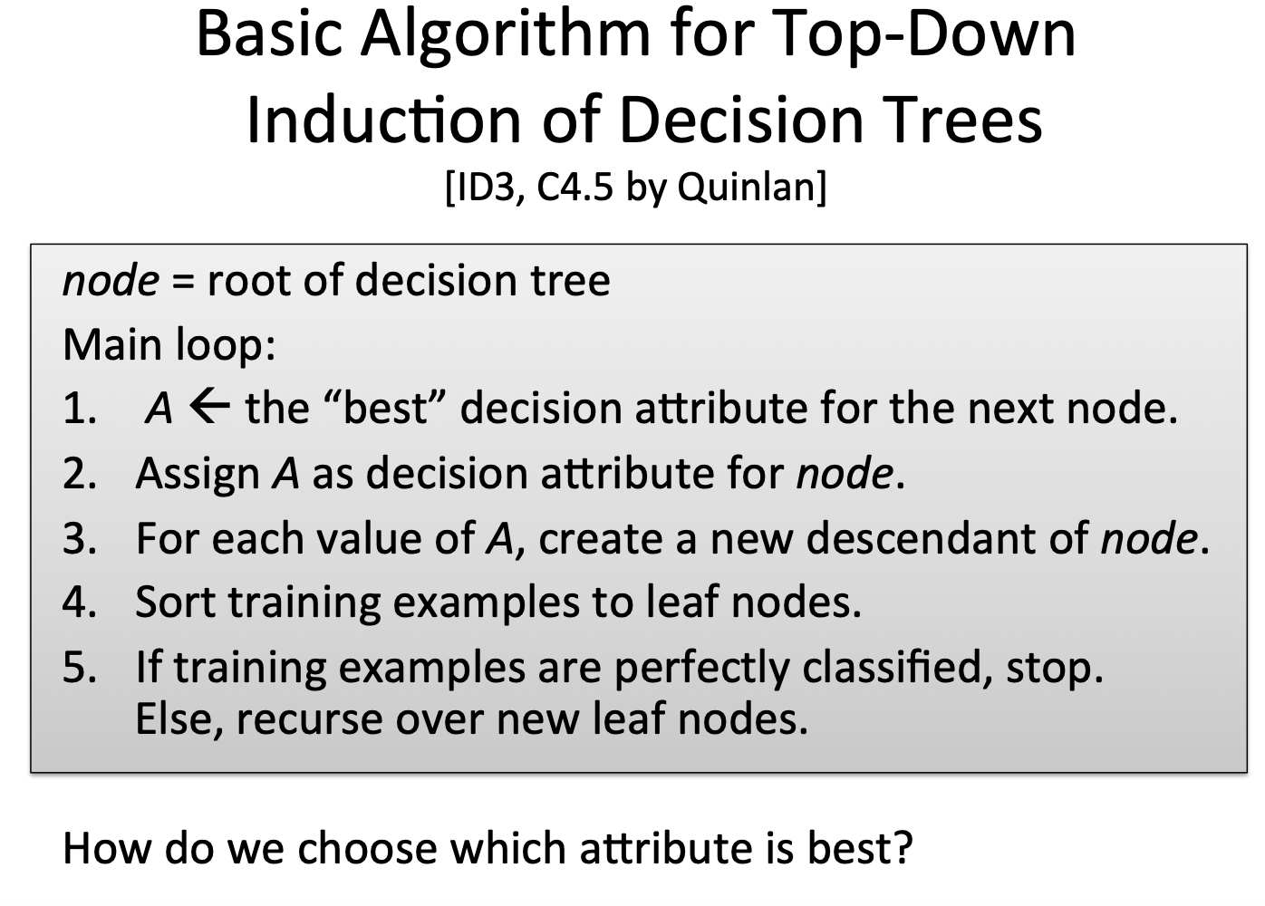

Slide 14
Entropy
In the context of Decision Trees, entropy is a measure of disorder or impurity in a node.
Thus, a node with more variable composition (multiple types) to have higher Entropy than a node which has only single type value.
The maximum level of entropy or disorder is given by 1 and minimum entropy is given by a value 0.

Slide 15
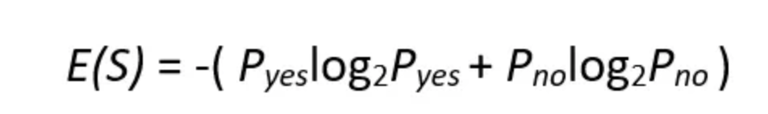
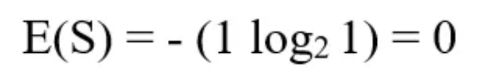
If we have a dataset of 10 observations belonging to two classes YES and NO. If 6 observations belong to the class, YES, and 4 observations belong to class NO, then entropy can be written as below.
P_{yes} is the probability of choosing YES and P_{no} is the probability of choosing a NO.
Here P_{yes} is 6/10 and P_{no} is 4/10.
If all the 10 observations belong to 1 class then entropy will be equal to zero. Which implies the node is a pure node.

Slide 16
If both classes YES and NO have an equal number of observations, then entropy will be equal to 1

Slide 17
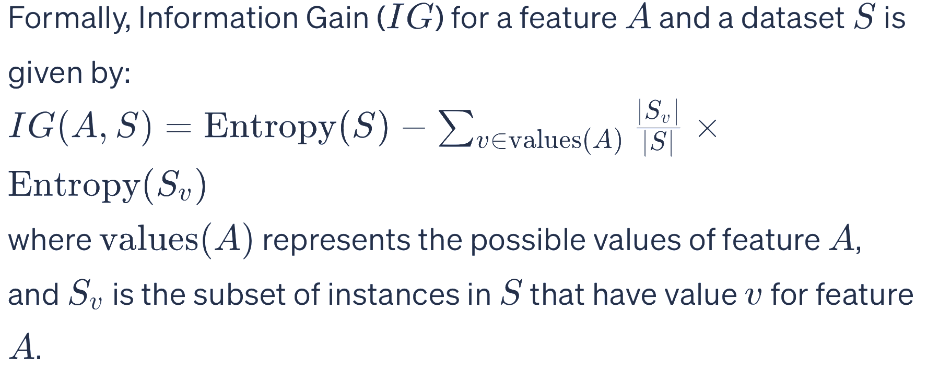
Information gain is used to decide on which feature to split on at each step in building the tree.
The Information Gain measures the expected reduction in entropy.
Entropy measures impurity in the data.
The feature which has minimum impurity (low entropy) will be considered as the root node.

Slide 18
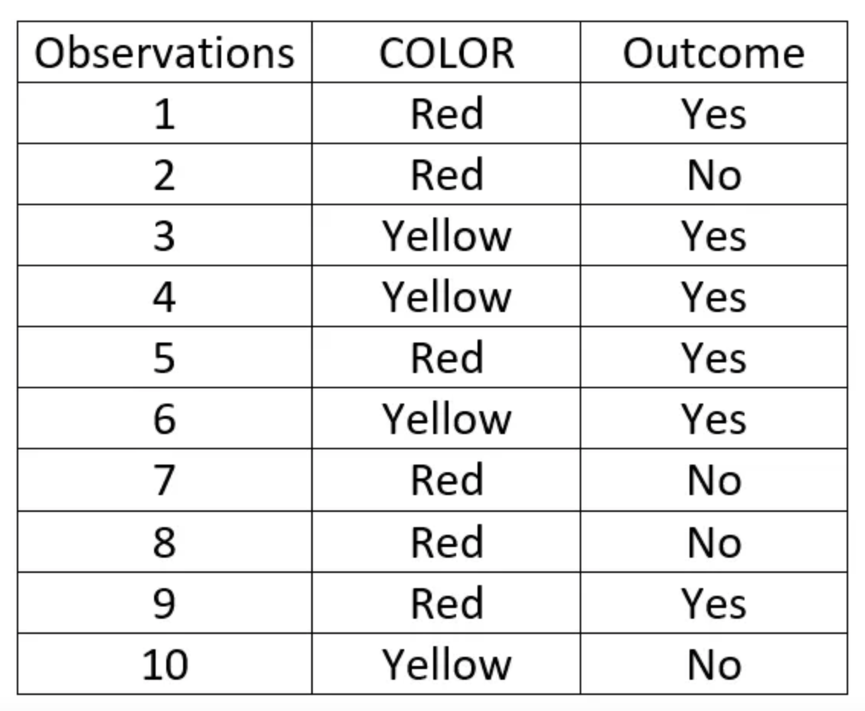
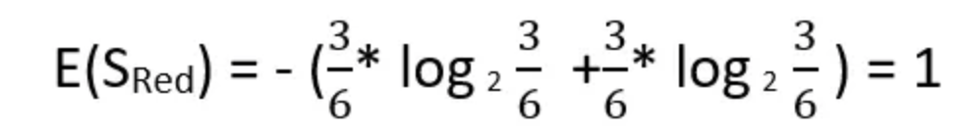
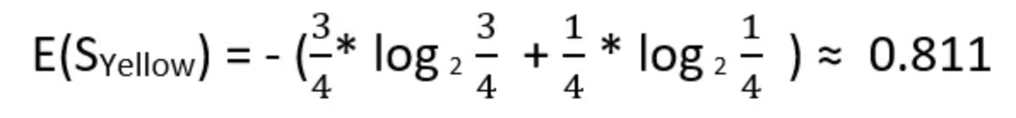
Red color has 3 Yes outcome and 3 No outcome
whereas yellow has 3 Yes outcome and 1 No outcome.

Slide 19
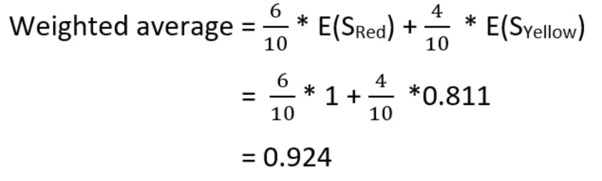
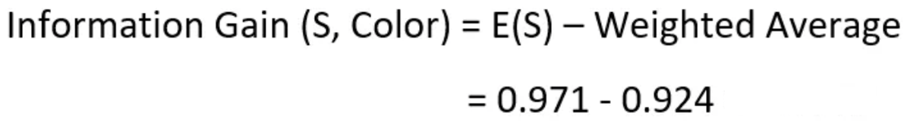
6 red color and 4 Yellow Color
For a dataset having many features, the information gain of each feature is calculated. The feature having maximum information gain will be the most important feature which will be the root node for the decision tree.

Slide 20
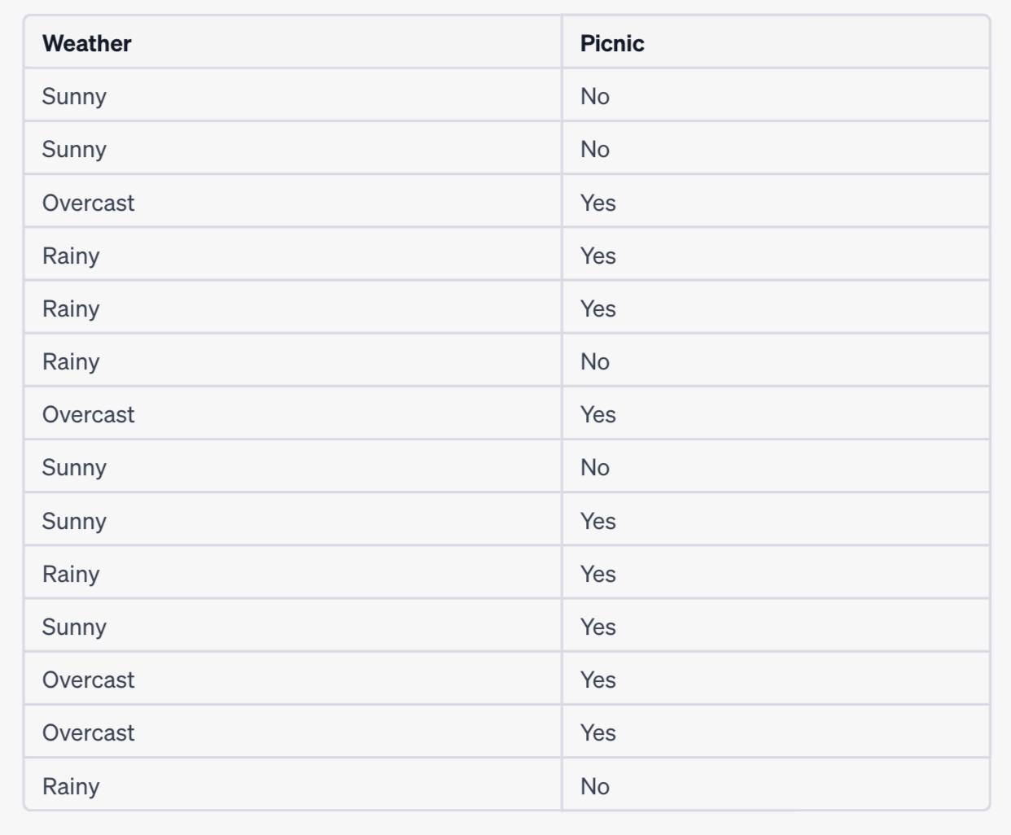



Sunny has ? outcome and ? outcome
$$E(S_{sunny})$$
Rainy has ? outcome and ? outcome
$$E(S_{rainly})$$
Overcast has ? outcome and ? outcome
$$E(S_{overcast})$$

Slide 21
